Slide 1
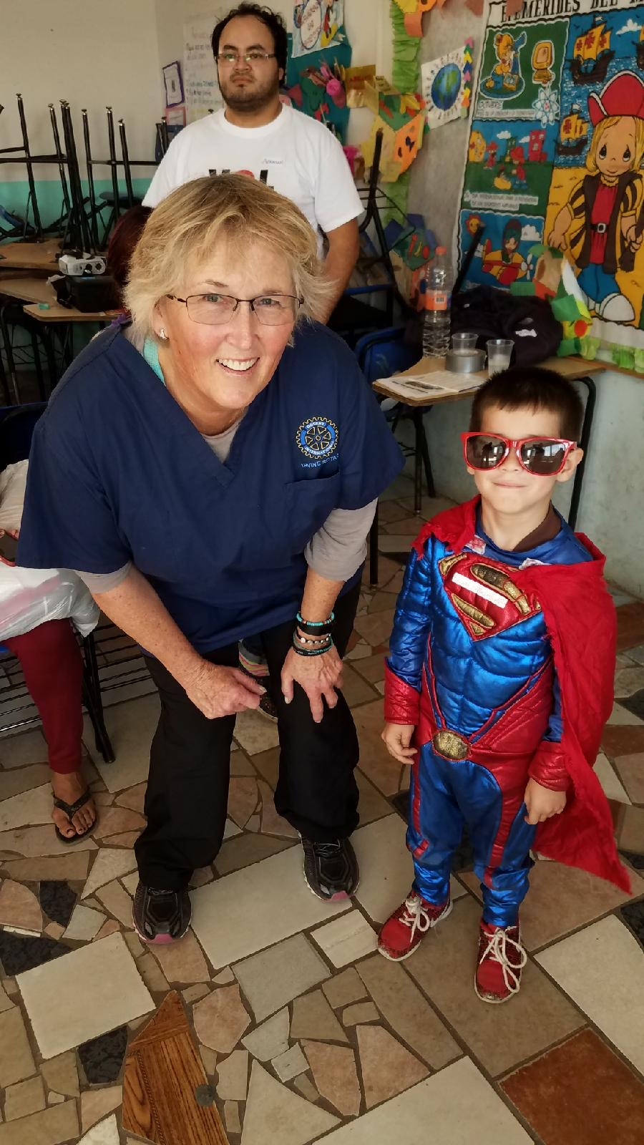
THE ROTARY FOUNDATION
CISCA STELLHORN, PDG
ROTARY CLUB OF IRVINE
DISTRICT 5320
At a DDF Vision and Dental
project in Ensenada ,Mexico

Slide 2

THE ROTARY Foundation
Doing Good in the world
Southwest pets 2025
Notes:
Rebecca
Now we’re going to take a look at a few reports that contain confidential donor information. For that reason, we will be using a slide format to look at these reports with fictional and scrambled donor information.

Slide 3
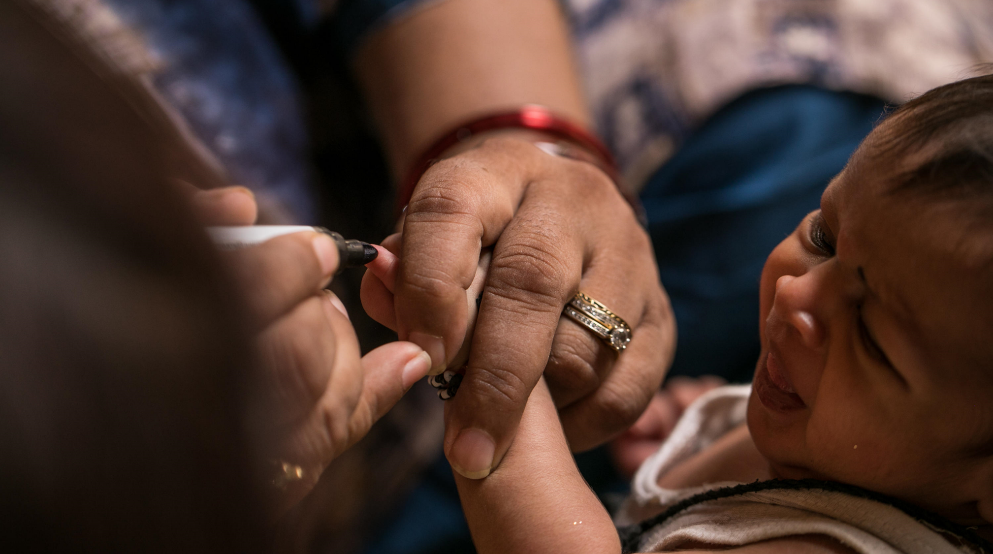
Rotarians, like you, to advance world understanding, goodwill, and peace through the improvement of health, the support of education, and the alleviation of poverty.
I believe the two most important words to remember are “enable Rotarians”. The Foundation is here to support the work that each of you are doing locally in district as well as around the world. to do that, we raise funds for the initiatives that are important to you and your community.
THE ROTARY FOUNDATION’S MISSION
The Rotary Foundation helps Rotarians to advance world understanding, goodwill, and peace by improving health, providing quality education, improving the environment, and alleviating poverty.
Notes:
When I talk to groups like yours I do so to encourage giving and knowledge of The Rotary Foundation. I’d like to acknowledge that this is a difficult time for many and that I am here today more so to inform you that The Rotary Foundation is here to help you in your goals to make an impact in your community.
To that end, The Rotary Foundation’s mission is to help Rotarians, like you, to advance world understanding, goodwill, and peace by improving health, providing quality education, improving the environment, and alleviating poverty.
I believe the two most important words to remember are “help Rotarians”. The Foundation is here to support the work that each of you are doing locally in district 6630 as well as around the world. In order to do that, we raise funds for the initiatives that are important to you and your community.

Slide 4
Rotary Foundation: Supporting your Club
Leverage the Rotary Foundation to help with club projects and engage your club in giving to the Rotary Foundation
Name
Title
District
contact
Notes:
No matter how you choose to give, I hope you will join me in supporting our Foundation with a gift to the Annual Fund this year. Remember, gifts of any size have a big impact when they’re leveraged through our Foundation and our network of Rotarians here and around the world.

Slide 5
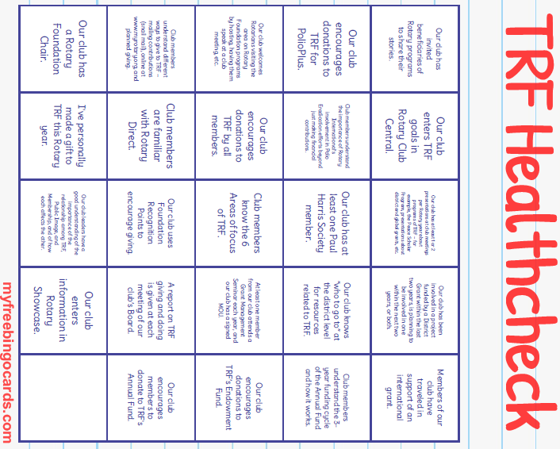
Rotary Foundation Bingo
Notes:
No matter how you choose to give, I hope you will join me in supporting our Foundation with a gift to the Annual Fund this year. Remember, gifts of any size have a big impact when they’re leveraged through our Foundation and our network of Rotarians here and around the world.

Slide 6
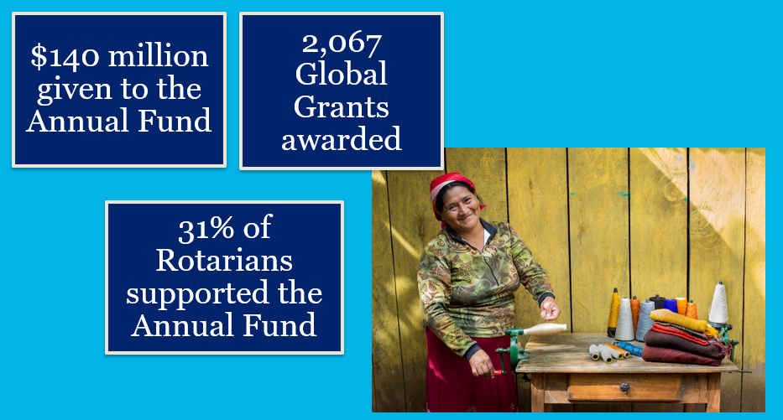
Rotary Foundation: Supporting your Club
TRF Grants: Global vs District?
Notes:
No matter how you choose to give, I hope you will join me in supporting our Foundation with a gift to the Annual Fund this year. Remember, gifts of any size have a big impact when they’re leveraged through our Foundation and our network of Rotarians here and around the world.

Slide 7
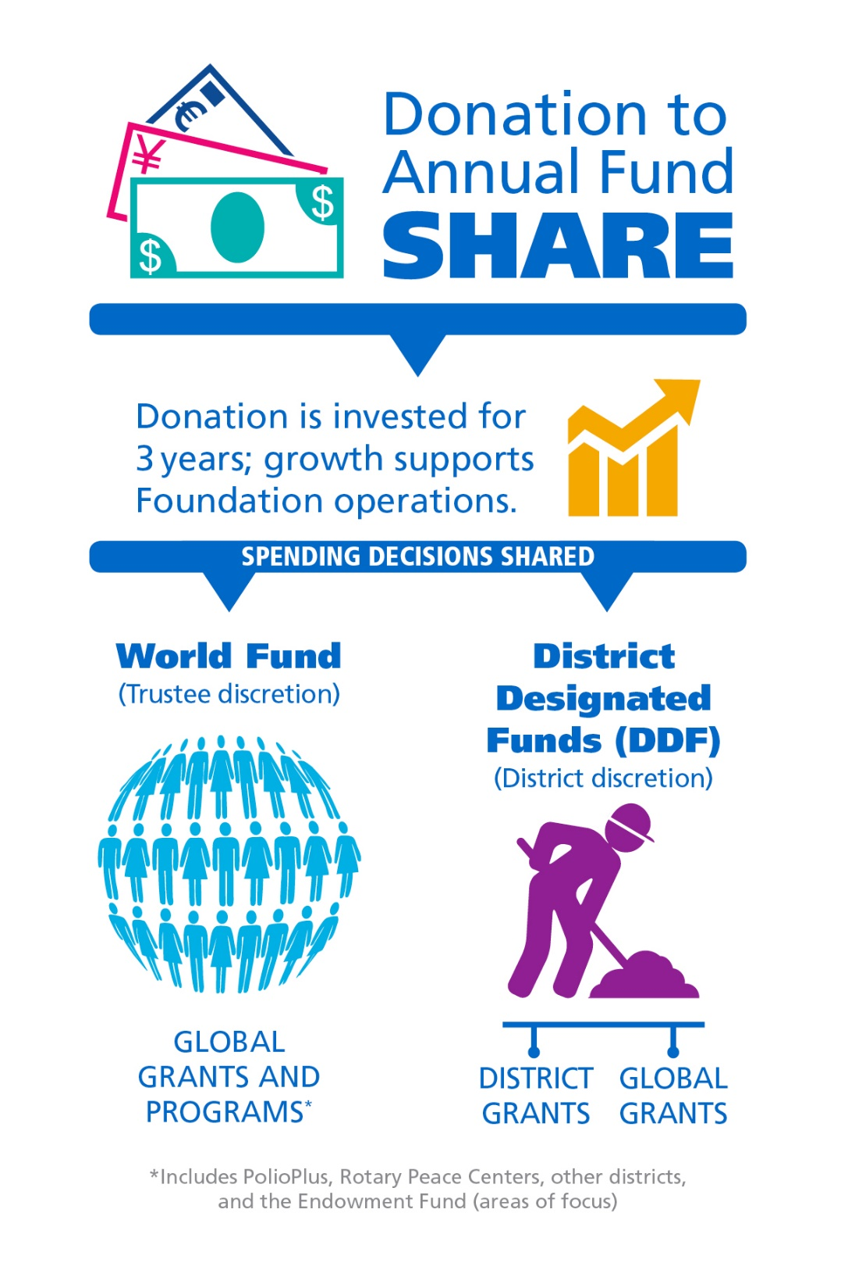
ANNUAL FUND -SHARE
When you give to Annual Fund – SHARE, The Rotary Foundation transforms your gifts into service projects that change lives close to home and around the world.
Learn more at: my.rotary.org/annual-fund-and-share
Notes:
When donors are asked why they support the Annual Fund, many say it’s because you get something back when you give. When you contribute to the Annual Fund-SHARE, part of your gift becomes available for your district and its clubs to use however they want on Foundation programs.
[Consider giving the following explanation, depending on the audience.]
When you donate to the Annual Fund-SHARE:
For three years, your contribution is invested.
After three years, that money is made available to fund projects.
A portion (47.5%) goes into your district’s District Designated Funds (also known as DDF). Your district can use it to help fund local and international projects. It decides how to use the money.
A portion (47.5%) goes to the World Fund. This money is used for grants, grant matches, Foundation programs that are available to all Rotary districts, or aid where the Trustees determine it to be needed most.
Districts that use both district grants and global grants get the full impact of gifts made by their members.
How many of you have participated in a global grant?
The World Fund is the source of the Rotary funding for your global grants.
And how many of you have participated in a district grant?
Those grants, too, are possible because Rotarians in your district gave to the Annual Fund.
The funds we have access to this year come from contributions made three years ago. (For example, funds available in 2022-23 are from contributions made in 2019-20.) That’s why it’s so important for members to support the Foundation consistently.
For more information about the Annual Fund, go to my.rotary.org forward slash EREY or annual-fund-and-share.

Slide 8
TRF COMPONENTS
THE ROTARY FOUNDATION
Annual Fund - Share
Polio+
Endowment Fund –Share (spendable earnings may be allocated to DDF)
World Fund
47.5%
DDF
47.5%
Notes:
Although the focus of our time together is the AF, I think it important to understand the different components of the Foundation so you know what AF is not, as well as what it is.
Polio+: Donations here go to Polio eradication and do not enter the Share system. Though Polio+ may receive DDF contributions.
Endowment goal: Rotarians are working toward the goal of reaching $1.0 billion in net assets* and $1.025 billion in commitments† for future gifts, totaling $2.025 billion for the Endowment by 2025.
Endowment Fund-Share: Spendable earnings from contributions enter the Share Systems. Gifts to the endowment are held in perpetuity; part of the earnings each year used for purposes specified by trustees and donors. Gifts to endowment support same programs as AF, but in perpetuity.
Annual Fund: PRIMARY SOURCE OF FUNDING FOR LOCAL AND INTERNATIONAL ROTARY ACTIVITIES contributions here each year (hence the name annual), enter the Share system. When you donate to the Annual Fund-SHARE:
For three years, your contribution is invested.
After three years, that money is made available to fund projects.
A portion goes into your district’s District Designated Funds (also known as DDF). Your district can use it to help fund local and international projects. It decides how to use the money.
A portion goes to the World Fund. This money is used for grants, grant matches, Foundation programs that are available to all Rotary districts, or aid where the Trustees determine it to be needed most.
World Fund: used to fund Global Grants & Programs (including Polio+, Peace Centers, and the Endowment Fund)
DDF: District Designated Funds: these funds come back to the district and can be used for District Grants or Global Grants. District has control of funds and in our District, we have long tradition of returning that money to clubs on the basis of their giving history. Districts may use any amount of their DDF for GGs or donations to Polio+, World Fund, Disaster Response Fund.
NB: Disaster Response Fund: can accept individual and DDF donations. Although separate from Annual Fund, contributions here count to EREY, Paul Harris Fellow and Society, Major Donor, and Arch Klumph recognition.

Slide 9
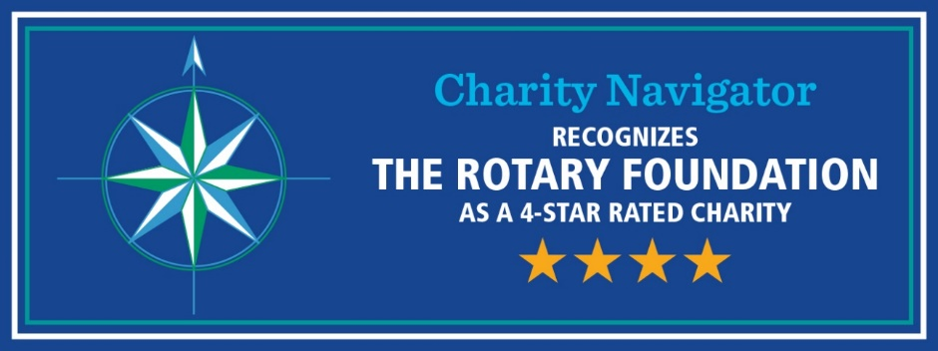
Outstanding performance
90% of funds are spent on program awards and operations
We’ve earned 15 consecutive four-star ratings from Charity Navigator
We’re an organization you can support with confidence.
The Rotary Foundation continues to far exceed the standards set by independent charity-rating services like Charity Navigator.
Notes:
You likely know this too: The Foundation is carefully overseen by your fellow Rotarians, the Trustees of The Rotary Foundation. They ensure that your donations are invested well and spent wisely so they’ll do good in the world.
Our members’ generosity and Rotary’s work haven’t gone unrecognized. For the 14th consecutive year, The Rotary Foundation has received the highest rating — four stars — from Charity Navigator, an independent evaluator of charities in the U.S., for demonstrating strong financial health and commitment to accountability and transparency.
The rating reflects Charity Navigator's assessment of how the Foundation uses donations, sustains its programs and services, and practices good governance and openness.

Slide 10

MYROTARY
REPORTS

Slide 11
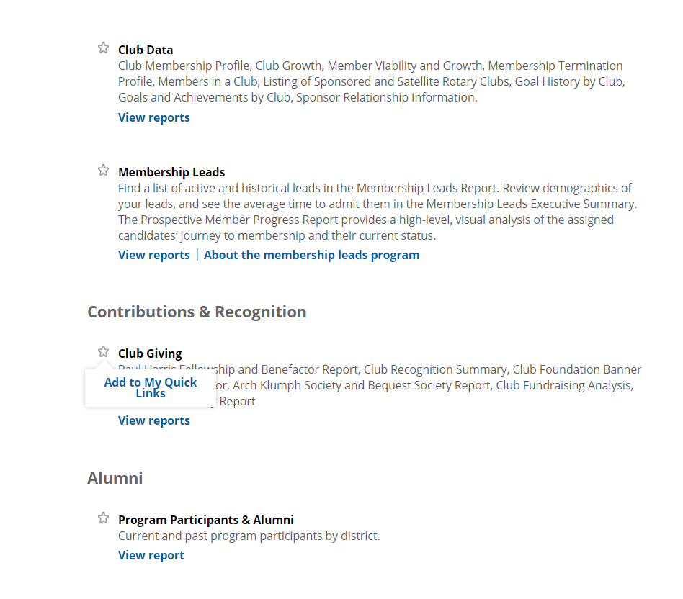
LOCATING FOUNDATION REPORTS
Notes:
Rebecca
To the (CLICK) Contributions & Recognition section under the Club Reports category.
Before we get into reports, I would like to take a moment to talk about Quick Links. A clear star (CLICK) next to a reports category indicates that category can be added to your Quick Links. Click on the star (CLICK) then click on Add to My Quick Links. The star will turn purple, and the reports category will now be available on your landing page once you sign in and in the upper right-hand corner of the reports page under My Quick Links.

Slide 12
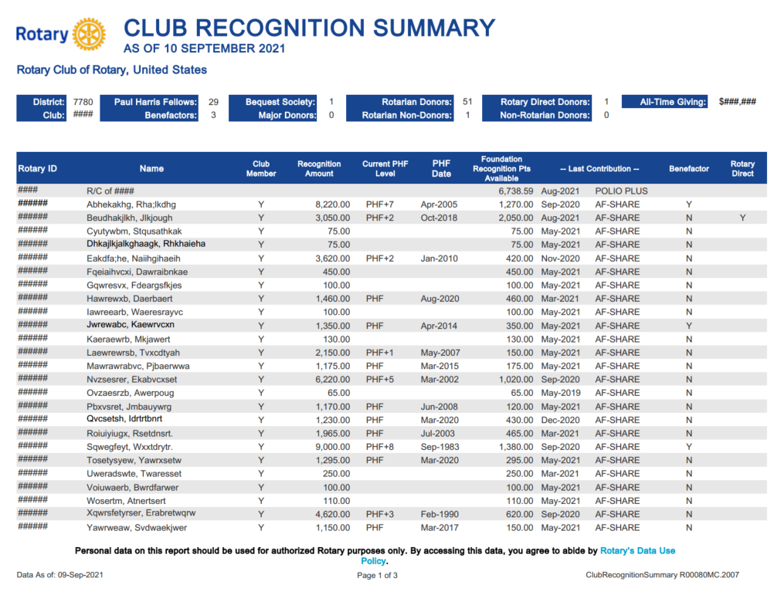
CLUB RECOGNITION SUMMARY
Notes:
Let’s start with the Club Recognition Summary. I talked briefly about Rotary Direct, and Club leaders can view who in the club is enrolled in Rotary Direct on this report(CLICK). It’s important to Keep in mind, this report is a recognition report and not a contribution report.
The Club Recognition Summary is a favorite and helps leaders with information on how many Foundation Recognition points are available in the club
(CLICK) as well as how many Foundation Recognition points each Rotarian in the club has.
(CLICK) Foundation Recognition Points are awarded in appreciation for personal contributions from an individual or organization and Foundation Recognition Points are only transferrable to other individuals to help them achieve their first or multiple PHF recognition or to recognize a business with a Certificate of Appreciation. Points accumulate 1:1 for every dollar contributed.
The Recognition Amount (CLICK) column indicates how close the donor is to achieving their next Paul Harris Fellow.
As I mentioned earlier, gifts to the Endowment Fund are not eligible for Paul Harris Fellow recognition and are not included in this column.
This report is intended for tracking recognition and points, and for confidentiality reasons, this report will not display recognition amounts greater than 9,000.
If the club has achieved a 100% Paul Harris Fellow Club banner in the past it will appear here (CLICK).
Lastly, you can view everyone's last contribution date/and fund (CLICK) and, the club’s all-time giving (CLICK).

Slide 13
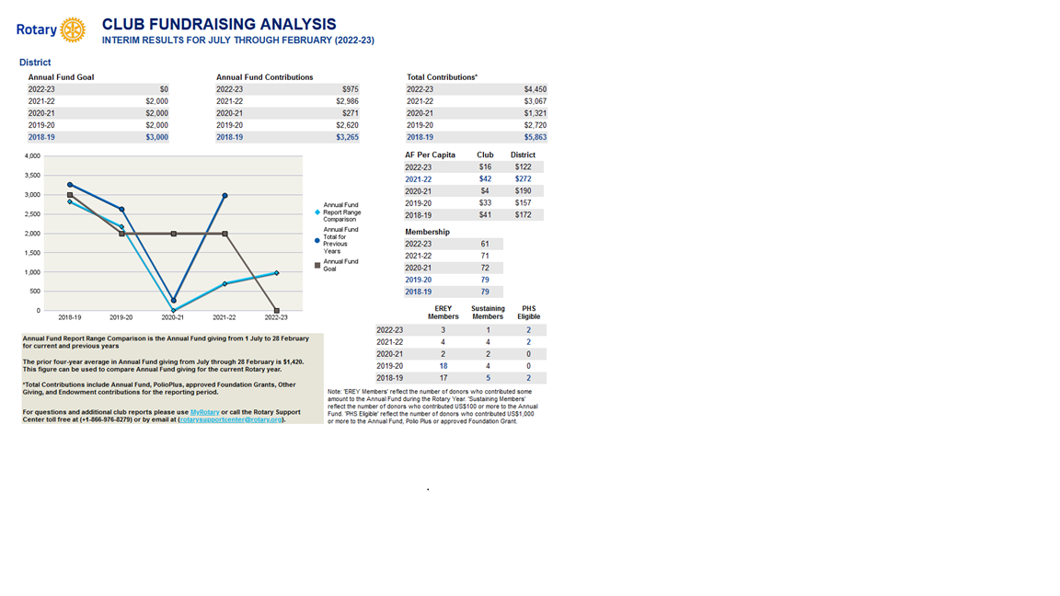
CLUB FUNDRAISING ANALYSIS
Notes:
Let’s start with the Club Recognition Summary. I talked briefly about Rotary Direct, and Club leaders can view who in the club is enrolled in Rotary Direct on this report(CLICK). It’s important to Keep in mind, this report is a recognition report and not a contribution report.
The Club Recognition Summary is a favorite and helps leaders with information on how many Foundation Recognition points are available in the club
(CLICK) as well as how many Foundation Recognition points each Rotarian in the club has.
(CLICK) Foundation Recognition Points are awarded in appreciation for personal contributions from an individual or organization and Foundation Recognition Points are only transferrable to other individuals to help them achieve their first or multiple PHF recognition or to recognize a business with a Certificate of Appreciation. Points accumulate 1:1 for every dollar contributed.
The Recognition Amount (CLICK) column indicates how close the donor is to achieving their next Paul Harris Fellow.
As I mentioned earlier, gifts to the Endowment Fund are not eligible for Paul Harris Fellow recognition and are not included in this column.
This report is intended for tracking recognition and points, and for confidentiality reasons, this report will not display recognition amounts greater than 9,000.
If the club has achieved a 100% Paul Harris Fellow Club banner in the past it will appear here (CLICK).
Lastly, you can view everyone's last contribution date/and fund (CLICK) and, the club’s all-time giving (CLICK).

Slide 14
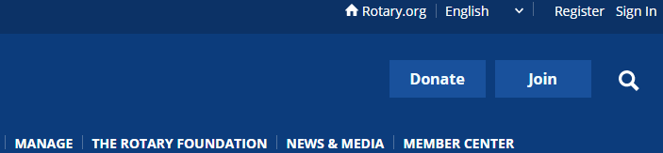
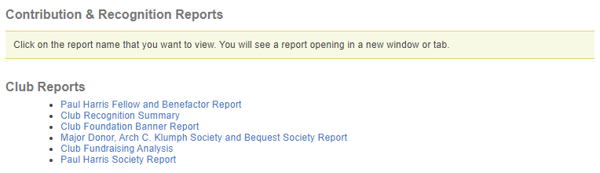
ACCESSING REPORTS IN myrotary.org
My Rotary
Notes:
Did you know that you can now manage your Rotary Direct donations through My Rotary?
Simply sign into your My Rotary account, or register if you don’t have one, at my.rotary.org. After you’re signed in, select Profile, then Donor Self-Service. You’ll see options to add, adjust, or cancel your recurring donations.
You can always contact the Support Center for help with Rotary Direct, but you can also easily make changes yourself through My Rotary.
Now, that I’ve shared a little about me and the benefits of The Rotary Foundation, I would like everyone to take a moment to reflect on your Rotary story and what inspires you as a Rotarian? Rotary? (PAUSE)
My inspiration is that how personal Rotary work has become to me.

Slide 15
ACCESSING REPORTS IN myrotary.org
My Rotary
Notes:
Did you know that you can now manage your Rotary Direct donations through My Rotary?
Simply sign into your My Rotary account, or register if you don’t have one, at my.rotary.org. After you’re signed in, select Profile, then Donor Self-Service. You’ll see options to add, adjust, or cancel your recurring donations.
You can always contact the Support Center for help with Rotary Direct, but you can also easily make changes yourself through My Rotary.
Now, that I’ve shared a little about me and the benefits of The Rotary Foundation, I would like everyone to take a moment to reflect on your Rotary story and what inspires you as a Rotarian? Rotary? (PAUSE)
My inspiration is that how personal Rotary work has become to me.

Slide 16
Rotary Foundation: Supporting your Club
Who is your…
Club Foundation Chair?
District Foundation Committee Chair?
Notes:
No matter how you choose to give, I hope you will join me in supporting our Foundation with a gift to the Annual Fund this year. Remember, gifts of any size have a big impact when they’re leveraged through our Foundation and our network of Rotarians here and around the world.

Slide 17
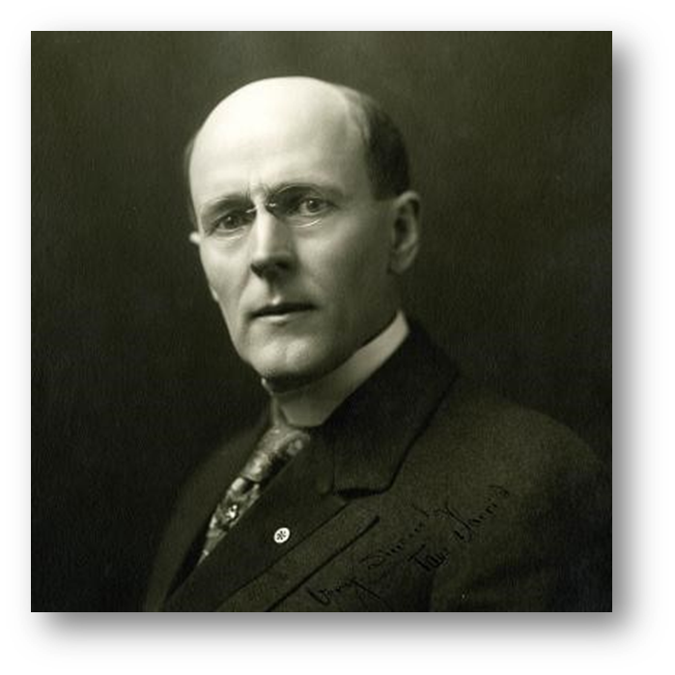
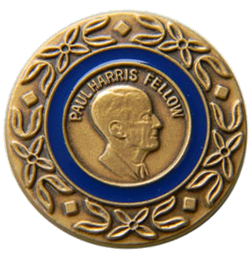
Paul Harris Fellow
The Foundation’s signature recognition
Individuals become PHFs when they reach 1,000 recognition points.
This can be done a giving to:
  The Annual Fund
  PolioPlus
  An eligible grant
Reaching 1000 points through a combination of outright giving and points.
Naming an individual a PHF by transferring points to them.
Notes:
We recognize our generous donors who give $1,000 or more to the Annual Fund, PolioPlus Fund, or an approved Foundation grant as Paul Harris Fellows. Donors receive one Foundation recognition point for every U.S. dollar they contribute. They can also use those points to name someone else a Paul Harris Fellow. It’s the Foundation’s most well-known individual recognition level.
The $1,000 contribution can be achieved through one gift or several gifts. Endowment Fund contributions, however, don’t count toward Paul Harris Fellow recognition.
Donors receive a pin and certificate at the first level. Those who give at this level multiple times receive Multiple Paul Harris Fellow recognition, including a pin with stones that correspond to the recognition amount.

Slide 18
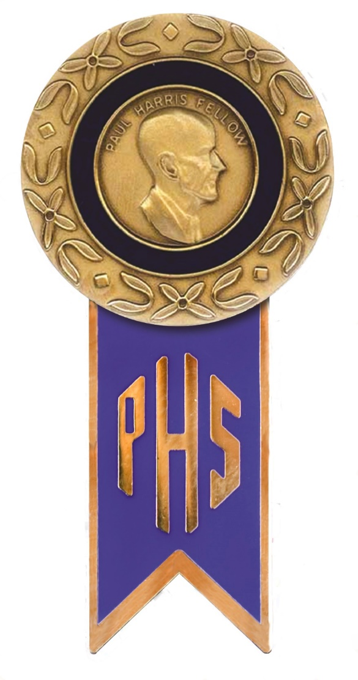
Paul Harris Society
A Commitment to The Foundation
More than 23,000 philanthropic leaders across the globe
PHS members give nearly 18% of Annual Fund donations
Donations fund local and international projects
Recognition earned for donors
Annual commitment can be met by giving as little as $85 dollars a month through Rotary Direct
Notes:
The Paul Harris Society aims to identify, engage, and recognize donors who have the ability and desire to make substantial annual gifts to help communities around the world.
The Paul Harris Society recognizes those generous donors who express their intent to give $1,000 each year to the Annual Fund, the PolioPlus Fund, or an approved Foundation grant.
Paul Harris Society membership has grown from about 10,600 in 84 countries since its launch in 2013-14 to more than 23,000 in 141 countries in 2018-19.
Additionally, contributions from the Paul Harris Society accounted for nearly 18 percent of Annual Fund contributions in 2018-19.
Society members’ consistent support is incredibly important to the district. It means that each year, the district can rely on gifts from these donors to fund meaningful district and global grant projects.
A simple way to meet that $1000 commitment is through Rotary Direct, our recurring giving program. For $85/month, you can join the Paul Harris Society and be a part of this important group.

Slide 19

Major Gifts
Paul Harris Society
Less than 3% of Rotarians contribute at or above the Paul Harris Society level, yet it represents over 19% of the Foundation’s Annual Fund contributions
$1000 Per
Year

Slide 20
Gifts
WHAT ARE THE GIFTS?
Every Rotarian Every Year (EREY)
Sustaining members (>$100 to the Annual Fund)
Paul Harris Fellows ($1,000)
Paul Harris Society Members ($1,000 per Year)
Benefactors ($1,000 to Endowment Fund)
Bequest Society (>$10,000 in estate plans)
Major Donors (>$10,000 outright or cumulative)
Arch Klumph Society (>$250,000 outright or cumulative)

Slide 21
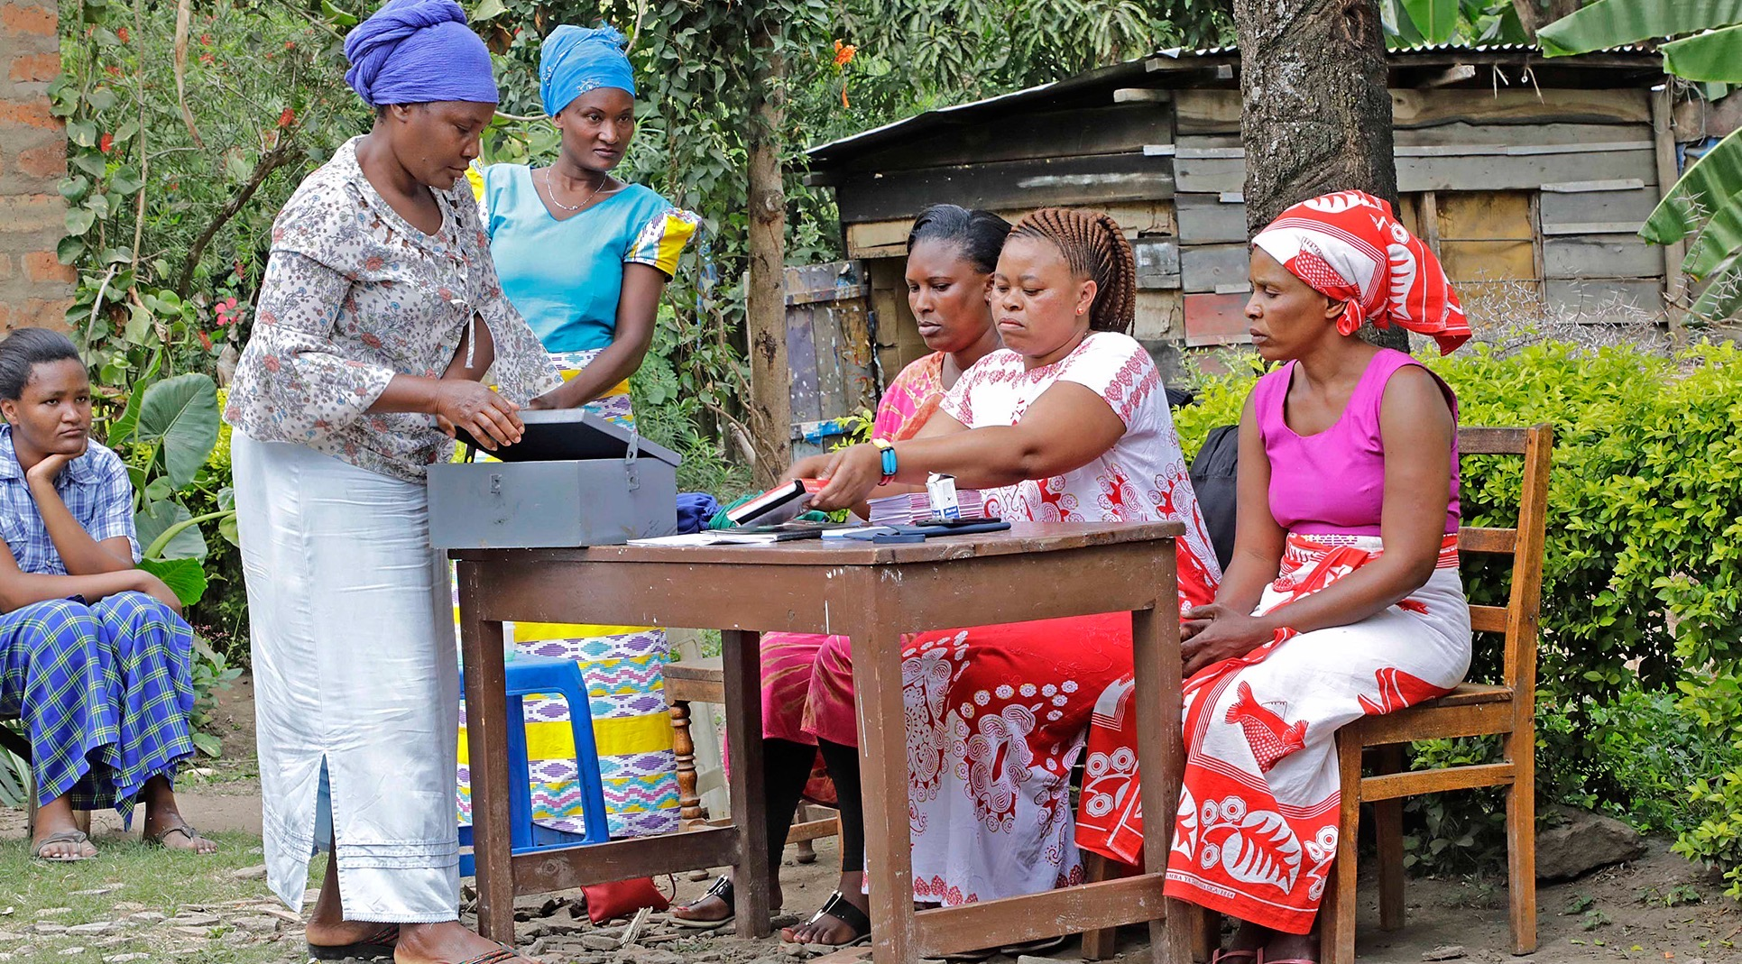
“
Everyone in Rotary is part of this great legacy; it is our responsibility to keep it going…I know the expectations are high. But I also know just how much our members can achieve.
Foundation Trustee Chair Ian H.S. Riseley
Rotary magazine, July 2022
”
Notes:
Stated simply, Rotary is a global network of people of action. We are neighbors, friends, and problem-solvers. We are committed to coming together regularly to learn and inspire each other by sharing our ideas, talents, and skills. We are dedicated to delivering real, long-term solutions to the world’s most persistent issues.
And we are just as committed to having fun and building strong friendships along the way.
Our vision statement says it best: “Together, we see a world where people unite and take action to create lasting change – across the globe, in our communities, and in ourselves.”

