Slide 1
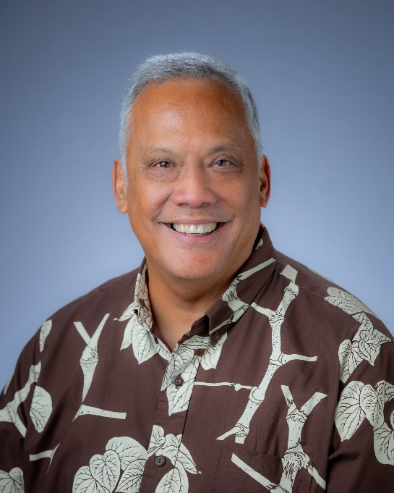
CLUB FUNDRAISING
AND EVENT PLANNING
BENSON MEDINA
ROTARY CLUB OF SOUTH HILO, DISTRICT 5000
DISTRICT GOVERNOR 2026-2027
benson.rotary5000@gmail.com

Slide 2
CLUB FUNDRAISING
Basic Questions
Why are we fundraising?
What will we do with funds we raise?
Whatʻs the capacity of my club?
Who will support our fundraiser?

Slide 3
CLUB FUNDRAISING
Basic Concepts
Unique “value proposition”
Identify the beneficiaries and involve them
Sponsorships should cover 80% of the expenses
Build an annual event the community will support

Slide 4
Creating a Fundraising Plan
Consider your club members first.
Think long term – annual event
Choose a cause or partners that will help the event
Develop a sponsorship package
Besides the club, the community needs to benefit
Donʻt miss the membership opportunity

Slide 5
Simple Event Planning Guide
Whatʻs the GOAL?
Plan the Event Details (type, venue, dates, budget, etc.)
Engage Your Club and Community.
Promote the Event
Execute and Evaluate

Slide 6
Questions Prospective Sponsors Will Ask:
A description of the event
Who will attend the event (demographics)?
What are the expenses of the event?
Who will the beneficiaries be?
How much exposure will we get?
How will we (the sponsor) benefit from the event?

Slide 7
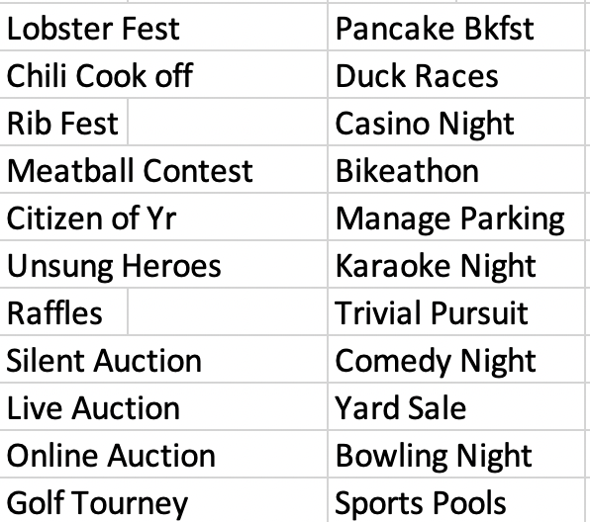
Some Fundraising Ideas

Slide 8
FUNDRAISING IDEAS BASED ON CLUB SIZE
SMALL CLUBS 1-17
MEDIUM CLUBS 18-30
LARGE CLUBS 30+

