Slide 1
Building and Leading a team

Slide 2
“The single biggest way to impact an organization is to focus on leadership development. “
-Author John Maxwell
Notes:
John Maxwell, a renowned leadership expert, reminds us that the single biggest way to impact an organization is to focus on leadership development.
By investing in our team's growth and empowering them to lead, we can catalyze transformative change and achieve greater organizational success.

Slide 3
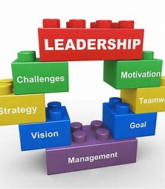
LEARNING OBJECTIVES
Agenda:
Develop a plan to assemble the team
Motivate team members and empower them to be successful
Build and manage the team effectively
Notes:
8:37am (5 min)- In the Getting Started session, you heard ideas about developing leaders in your club, this session will drill it down to your board and building a team to lead the club.

Slide 4
Have the right mindset
Plan
Raise your Rotary I.Q
Observe
Explore
Ask
Notes:
8:42 ( 8 min) Effective Rotary leaders cultivate a strategic mindset, constantly observing, exploring, and asking questions to understand the big picture and guide their team. This planning approach empowers them to make informed decisions and drive positive change within their organization.
By raising their "Rotary I.Q." through careful observation, inquiry, and reflection, leaders can develop a nuanced understanding of their members' needs and identify the best ways to support the club's mission and growth.

Slide 5
BuiLding the team
Determine Roles
Define the key roles and responsibilities
Recruit Strategically
Seek out talented individuals and build a diverse team
Develop Trust
Get to know team members. Foster an environment of open communication, collaboration, and mutual respect.
Notes:
Define the key roles and responsibilities that need to be filled on your team. This will help you identify the right individuals with the necessary skills and experience. Recruit Strategically
Seek out talented individuals and uild a diverse team with a range of perspectives and expertise.

Slide 6
Team success Factors
Notes:
“Popcorn” answers : get brief ideas from group on how to keep team members engaged and inspired through out the year.

Slide 7
Discussion question
How do you build a successful team and ensure you have continuity?
Notes:
8:52 ( 10 min) Ensuring the right person is in the right position is crucial for team success. Consider their skills, experience, and ability to contribute to the team's goals. Observe how they interact with others and their enthusiasm for the work. Regular check-ins can help identify areas for growth and improvement.

Slide 8
Leading the TEAM FOR SUCCESS
Have a Strategic Plan in place and Share its Vision. Get a buy-in and clearly communicate.
2. Empowering the Team –Delegate, celebrate successes
3. Provide resources – what do they need to be successful
3. Inclusive Leadership – Listen, value diverse perspectives,
open communication
Notes:
Adjust your behavior to the team . What leadership style fits the situation? Participative – collaborative environment. Situational – based on a task. Transformational – motivated to exceed expectations. Servant - needs of the team. You may need to give more direction, others just need encouragement, coaching or freedom. Shared Vision
Get buy-in by clearly communicating the team's shared vision and goals. Ensure everyone understands how their individual contributions fit into the bigger picture.
Empowering Team
Empower your team members by delegating responsibilities, providing resources, and giving them the autonomy to make decisions. Celebrate their successes and foster a supportive environment.
Inclusive Leadership
Practice inclusive leadership by actively listening to your team, valuing diverse perspectives, and encouraging open dialogue. This will build trust and boost morale.

Slide 9
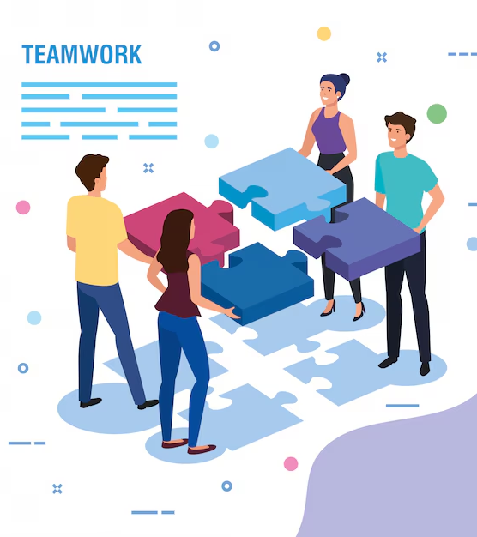
Discussion Questions -
With differing personalities, how would adjust your and the team members’ behaviors to improve the effectiveness of the team?
Notes:
9:20 (5 min) Working together is critical to get things done. By identifying and understanding differing personalities, you can adjust your behavior to improve the effectiveness of the team and promote teamwork. In your small groups, talk about how you might adjust your behavior to suit a differing personality.

Slide 10
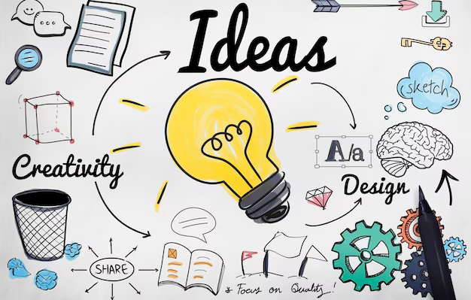
Action plan – develop goals
Write down your thoughts on how you’ll lead and inspire them to reach their goals.
How will you build up the next generation of leaders for continuity?
Notes:
9:30 (2 min) Take a moment to write down your thoughts on what you need to do to build and support the team. As team leader, you are responsible for motivating members and the board to achieve Rotary goals. Considering that you are all volunteers, with different personalities and priorities, think about how you’ll lead and inspire them to reach their goals.

Slide 11
Resources
https://learn.rotary.org/
Toastmasters –
- Building Consensus
- Communication Skills
- Leadership Basics
- Leadership Fundamentals
- Leadership Skills
- Leading a Team
Notes:
Bob

Slide 12
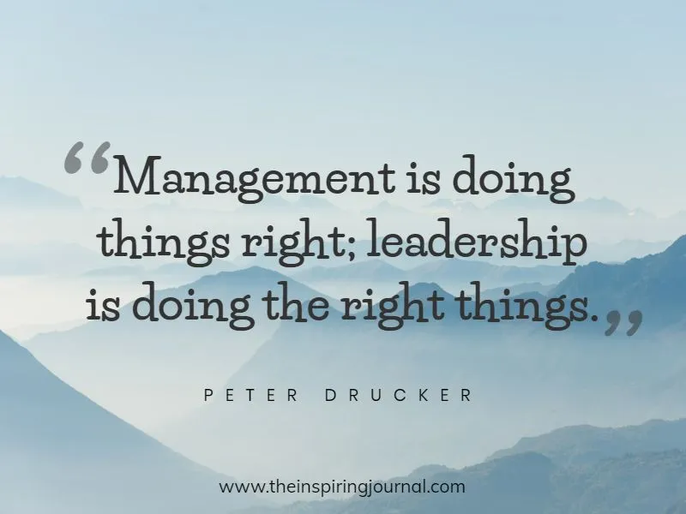
12
“Management is doing things right; leadership is doing the right things.” – Peter Drucker
John Doe
Notes:
In Hawaii, we have a word. It’s Kinaole, that means doing the right thing at the right time, for the right reason the right way, for the right person – the first time

Slide 13
Thank You!

