Slide 1
CLUB CULTURE/EXPERIENCE
NAME
Title
District

Slide 2
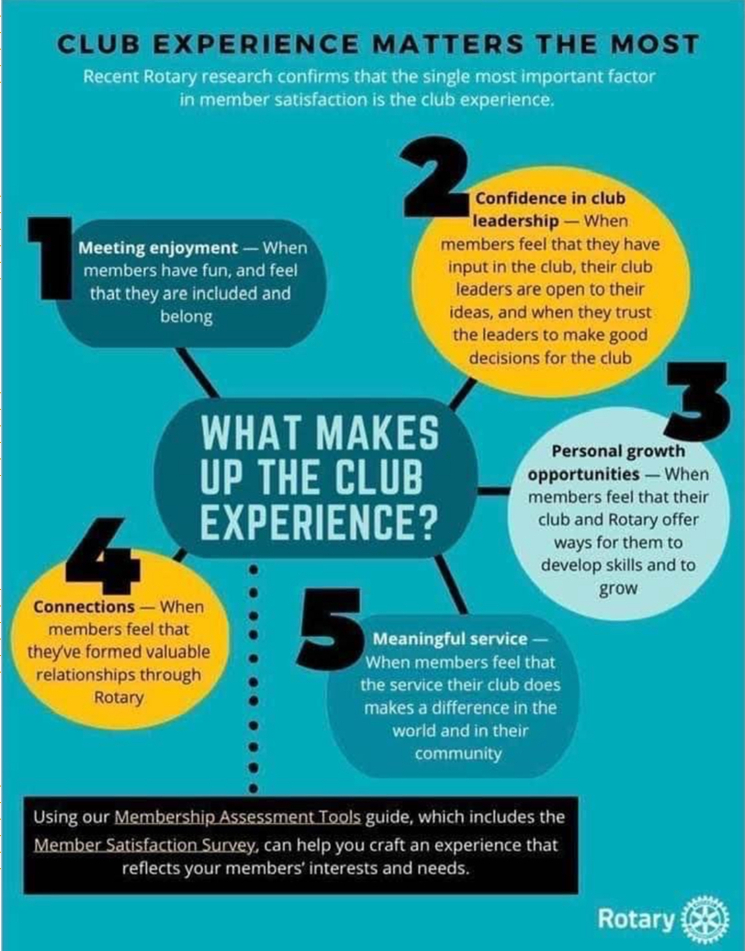
Notes:
Will be in the toolbox on the website

Slide 3
Notes:
Will be in the toolbox

Slide 4
What is one thing that your club does well to enhance the club experience???
What is one thing your club could do better??

Slide 5
As President ..what is your role
in the club culture and experience??

Slide 6
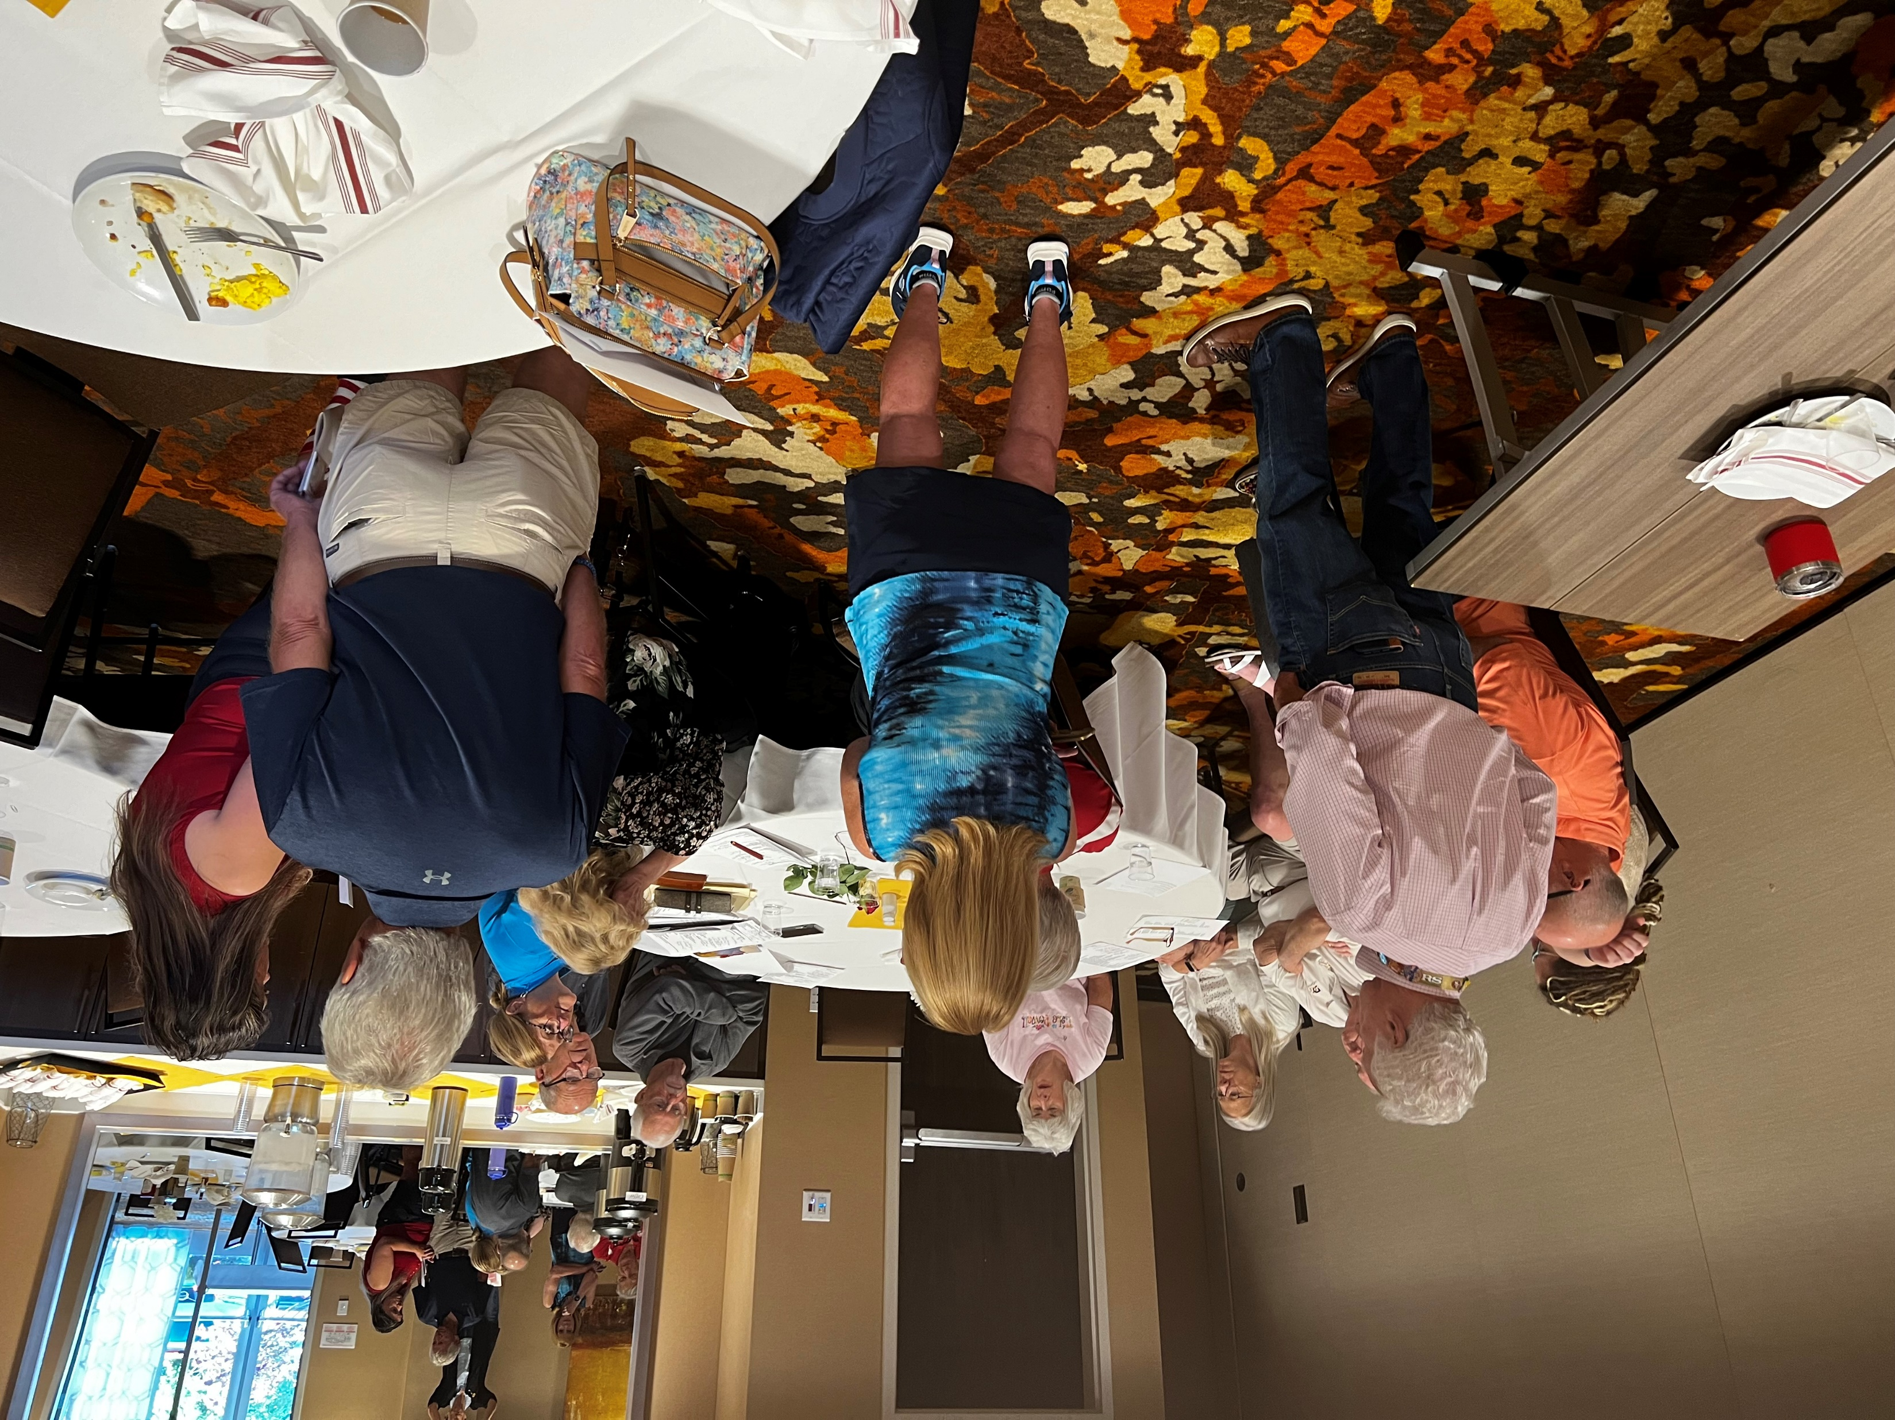
Table Discussion

