Slide 1
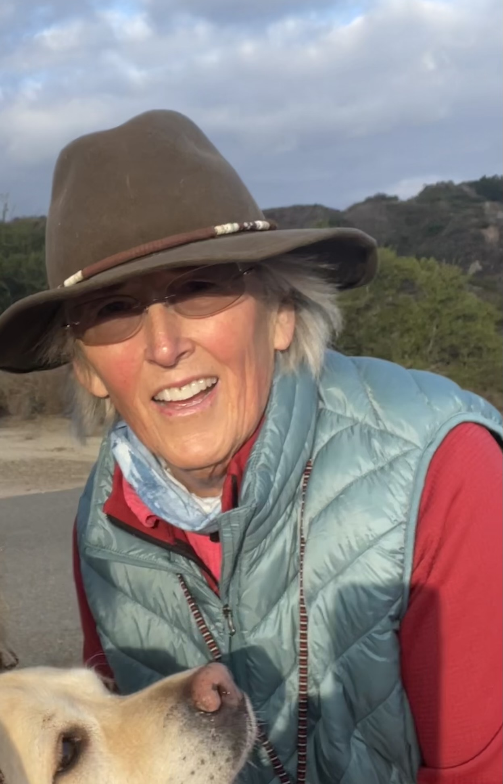
COURAGEOUS CONVERSATIONS
Cisca Stellhorn, PDG 5320
Rotary Club of Irvine
“youknowmea”

Slide 2
COURAGEOUS CONVERSATIONS
HOW TO HAVE A CONVERSATION,( DEEP OR MEANINGFUL) ON DIFFICULT TOPICS

Slide 3
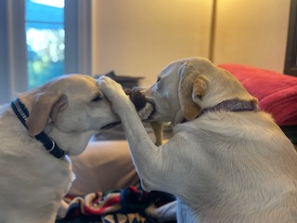
These are conversations between people we know or care about or desire to engage with

Slide 4
Exercise 1-4min. Start right after introductions.
(4min)
1. Each person in the room pair up with someone you do not know-10 sec
2. One person is the listener, one person is the speaker- 10 sec
3. The speaker is to “convince” the listener to sit with him/her at lunch. -1min
4. Take 20 sec to think to yourself how that made you feel
5.. Switch roles ( listener becomes the speaker.) 5 sec
6. The new speaker now “invites” the listener to sit with him/her at lunch. 30sec
7. Everyone sit 30sec.
8.. Now ask the 1st listener to share how did that feel using 4 words -15 sec. Were you “convinced”?
9.. Switch to the 2nd listener to share how did it feel to be “asked”, using 4 words- 15 sec.

Slide 5
What did we learn from this exercise?
1. Language is important. Use it to invite versus force.
2. Realize you cannot force anyone to do something they do not want to do.
20sec

Slide 6
COURAGEOUS CONVERSATIONS
Rotarians provide service to others, promote integrity, good will and peace.
We live by the 4 way test
We are a community based on common goals and needs
We are also human and with that there can be polarization-it is not good nor bad
Polarization can be good if it promotes space for diverse viewpoints not so good if it is used to dehumanize. What is meant by Dehumanize?

Slide 7
Discourse/Polarization is not good nor bad
About facts, opinions, feelings, etc. Dialog stimulates creativity, develops understanding, creates awareness, cultivates relationships, expands our world view, can agree to disagree
TOXIC POLARIZATION however makes it about people -dehumanizing, focus is not about opinions nor ideas it is about wrong or blame, us vs them, assigns fault based on differences not reality, divides, no middle ground, it is me or you not us.

Slide 8
HOW DO WE PROVIDE SPACE FOR Diverse Viewpoints
Do we take time to listen and honor others view?
Are we open to new possibilities and stay curious?
Do we center conversations on our common humanity?
Do we remember that we each have different comfort levels in dialoging?
Do we acknowledge that we can agree to disagree? Not my way or the highway.

Slide 9
Language
Do we invite one to a conversation? Would you have time to------?
Do we Encourage? Validate? Appreciate? I know that this is a hard subject and I appreciate that-----
How would you like to approach this subject?
How does this make you feel?
Use “I” “We” “Us”

Slide 10
Tools
Control the environment- when, where, who?
Stay calm, breathe, stop a beat
Stay centered and focus on the topic
Control the process not the content of the conversation
Be mindful -stay curious

Slide 11
4 Scenarios to explore
One half of the tables will exam exercise 2 and 3
The other half of the tables will examine exercises 4 and 5

Slide 12
Exercise 4
The club speaker and 4 Club members appear on Zoom. The speaker is to speak on the Environment. About 5 mins into the presentation the speaker moves into a clearly partisan political agenda There is grumbling among the audience and 2 members leave the meeting. The Club’s policy is no partisan political speakers.
The Club president asks the speaker to keep on topic but he refuses. The speaker is eventually cut off.
One long time member jumps up and storms out of the meeting making loud rude remarks on his way out the door. Everyone hears and sees him leave.
How would you have handled this situation? With the speaker? With the Rotarian who stormed out? With your club members?
Assume there were 3 prospective new members in the audience. What steps would you take to address the situation with them?.

Slide 13
REPORT OUT -WHAT ONE THING DID YOU LEARN? (30 sec)
WAS THIS HELPFUL?

Slide 14
QUESTIONS???

Slide 15
THE END

