Slide 1

Strengthening Rotary’s Public Image

Slide 2
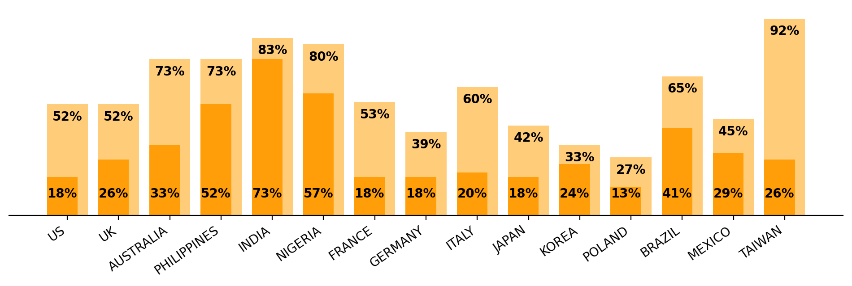
Global insights
Awareness versus Understanding
Have you heard of an organization called Rotary? (awareness)
How familiar are you with the work that Rotary does?
(understanding)
Source: Rotary Global Public Image Research, Dec 2022
Notes:
A high level of brand awareness doesn’t always correspond to understanding. While markets such as Philippines, India and Nigeria benefit from high levels of both, others such as US, Australia, European countries and Taiwan can benefit from increased information about Rotary so that the public understands who we are, what we do, and how we are relevant.

Slide 3


Slide 4

Public Image – what is ours?
  While many people have heard of Rotary, the public does not have a consistent understanding of who we are or what we do
Q: What comes to mind when you hear the name Rotary or Rotary Club?
Source: Rotary Global Public Image Research, Dec 2022
Notes:
How do others see us? We regularly conduct research around the world with the general public to assess what they know and think about Rotary. And while the responses vary from market to market, on thing remains the same – while some of the descriptions are accurate, there are a lot of misperceptions about our brand. In fact, many people respond “don’t know” when asked What comes to mind when you hear the name Rotary or Rotary Club?

Slide 5

Expanding our Reach is a pillar of our Action Plan
Increase
Impact
Expand
Reach
A
Stronger Brand
Aims to introduce new audiences to Rotary in a consistent and relevant way
Increase
Our Ability
to Adapt
Enhance Participant Engagement
Notes:
Expanding our Reach is one of the key pillars or our Action Plan which aims to strengthen and grow Rotary. To that end
we need to continue to narrow that gap between awareness and understanding among the general public as well as
drive internal awareness and understanding of the priorities, because they all work together to make us a stronger and more attractive organization for current and future members and participants

Slide 6
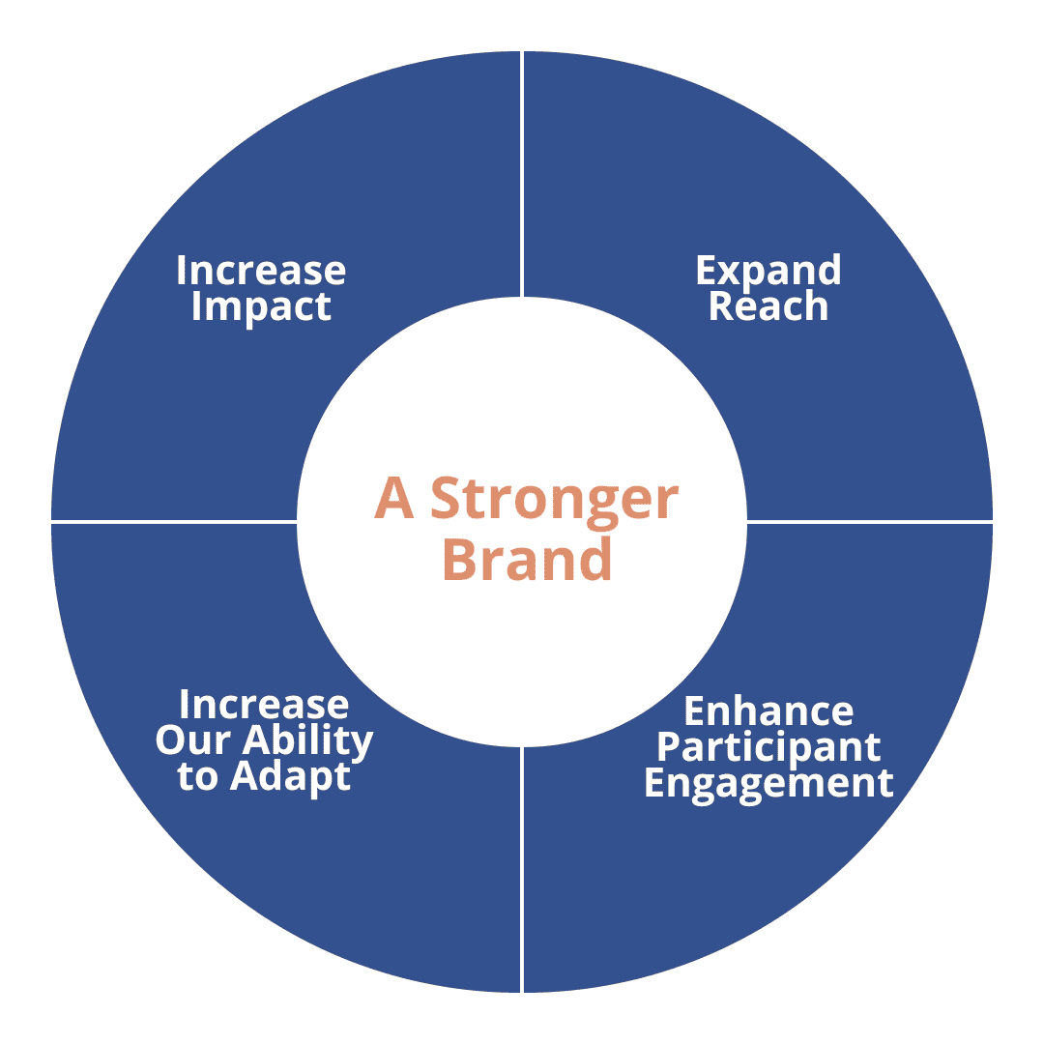
Strategies to expand our reach
People of Action
Increase
Impact
Expand
Reach
1.2 million members
A
Stronger Brand
Visibility and promotion
Increase
Our Ability
to Adapt
Enhance Participant Engagement

Slide 7

People of action messaging resonates
87% of those aware of Rotary had a positive opinion of the phrase
91% of those agreed that People of Action is a good descriptor of Rotary
Opinions of Rotary increased 8% on average in all countries after exposure to People of Action messaging and/or imagery
Source: Rotary POA global message testing 2021

Slide 8
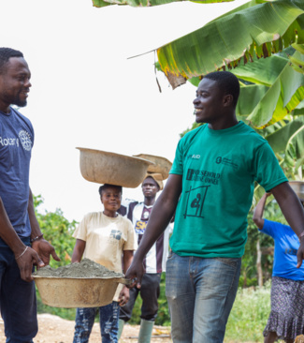
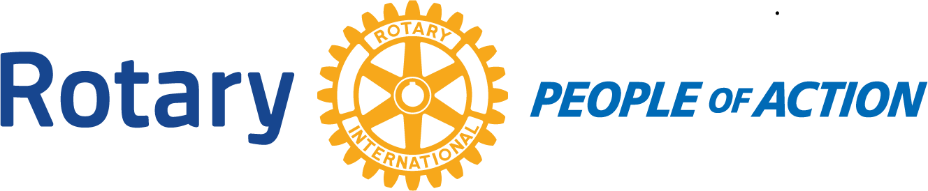
subhead
But…
people of Action is more than an advertising campaign​
​
It’s who we are and what we do

Slide 9
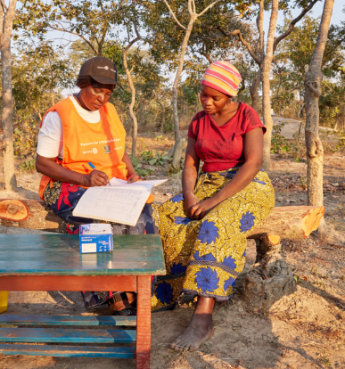
People of action stories
Focus on a local issue or challenge​
Show how we work together to find a solution​
Explain how local members took action​
Tell the community of the impact you’ve made
Notes:
People of Action stories follow this framework​
Start with your local challenge or issue​
Show how your club worked together to find a lasting solution​
Talk about how you mobilized resources in your community to take action​
Talk about the impact this project had​
Share your story with the public
​Make sure to include a Call to Action – let your audience know how they can connect with you, what you want them to do next.

Slide 10
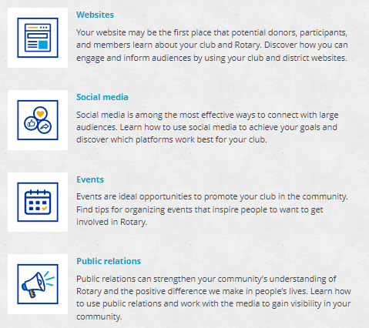
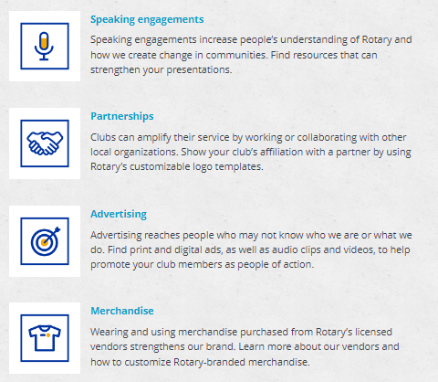
Ways to Promote Rotary
Notes:
Integrated marketing strategies can maximize the effectiveness and build upon each other

Slide 11
Resources for clubs
Learning courses
Presentations
Videos
Photo and media library
Templates
Assets and ads
Tips and guidance
Club resources
On the Brand Center, Learning Center and myrotary.org
Notes:
Many resources are available to help you obtain local media coverage and make use of the tools Rotary provides. Take time to peruse the Brand Center, Learning Center and myrotary.org for resources.
Make use of the the specialists at Rotary International World Headquarters or the international offices for additional support.

Slide 12



What’s your story?
Notes:
contact us at pr@rotary.org

