Slide 1
One Voice, Every Club - Your Logos
Title Page Option
Notes:
At the end of this presentation, you’ll learn
-Why its important to use our logos correctly
-How to use our logos correctly
-Resources to effectively use our logos correctly in your club

Slide 2
Rotary international logos
Masterbrand Signature
Mark of Excellence
Masterbrand Signature Simplified
Notes:
Let’s start with some terminology.
This is Rotary’s logo, or what is referred to as the Masterbrand Signature. It consists of the word Rotary and the Rotary wheel. Below the MBS is the simplified logo. Either of these logos can be used as our Rotary logo.
Then, there’s the Mark of Excellence, which is the Rotary wheel on its own. It is always used in combination with the Masterbrand Signature, and is always depicted much larger than the Masterbrand Signature. Please notice that we don’t offer the simplified logo as the mark of excellence.
These elements are the base of Rotary’s visual identity. Every club, district, and program is to use the Masterbrand Signature its visual identity.
The logo cannot be manipulated. You wouldn’t manipulate any other brand’s logo.

Slide 3
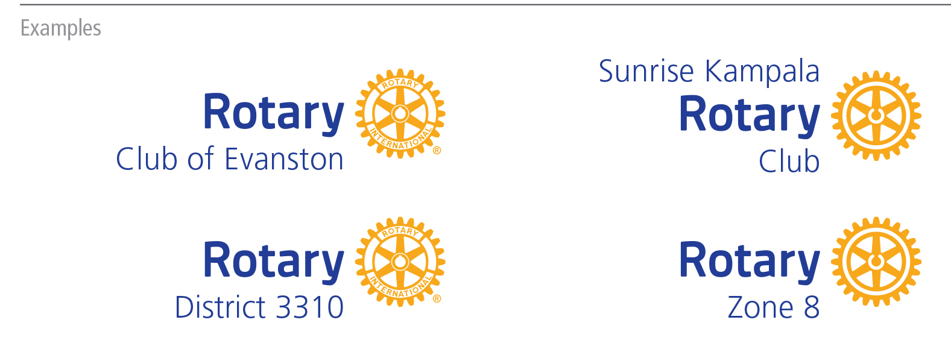
CLUB, DISTRICT, & ZONE LOGOS
Notes:
Only Rotary International can use the Masterbrand Signature on its own. Clubs, districts, multi-districts and zones can only use the Rotary logo with their club, district, or zone name. This applies to Rotary, Rotaract and Interact clubs.

Slide 4
Protect Rotary’s name and intellectual property​
Credit and recognize members, clubs, districts, and programs for the good work they do ​
Tell Rotary’s story in a consistent way
WHY It’s important to use the Rotary marks correctly
Notes:
Here’s why it matters for Rotary. But it’s not just Rotary, correct branding is important to every global brand. Think about your own business. Does it matter that your customers can easily identify you or distinguish you from others? Rotary is no different.
Like Coca-Cola, McDonald’s, and UNICEF, we must protect our name and intellectual property. It’s how we can grow our organization, increase our impact, and maintain our reputation as an organization that can be trusted. Misuse of our logo only weakens our brand.
Second, when a local club uses the Masterbrand Signature with their club name, they get credit for their good work in the community while leveraging the power of the Rotary’s global brand.
And finally, our logo helps us tell Rotary’s story in a consistent and compelling way. It’s our visual identity, No matter where you are in the world, if you see a Rotary club logo, you know that club is part of an international network of people of action.

Slide 5
subhead
Four key guiding principles
Notes:
Now that you see why it’s important to use Rotary’s logos properly, let’s talk about how Rotary’s logo should be used.

Slide 6
1.
Always use a club or district identifier when using the Rotary logo. They must be aligned with the Rotary logo.
Notes:
Rule #1: Always use a club or district identifier when using the Rotary logo.
A club can use the name they are known by locally, adding their club name above or above and below the Masterbrand Signature, like you see here. The layout you choose depends on how you say your club’s name. Create your club logo in our logo creator in the Brand Center.

Slide 7
2.
Never obscure the Rotary wheel, use a partial wheel, manipulate the wheel, or use the wheel as an object.
Notes:
Rule #2: Never obscure the Rotary wheel, use a partial wheel, or manipulate the wheel in any way. The Mark of Excellence should only be used with the Masterbrand Signature. Don’t manipulate Rotary’s logo by making it into a pancake, place it on top of an apple, as a bike wheel, or the number zero.

Slide 8
3.
Do not use images or graphics within the Rotary logo.
Notes:
Rule #3: Do not use images or graphics within the Rotary logo. Nike wouldn’t add a tree behind their swoosh, nor should we add anything extra to the Rotary club logo.

Slide 9
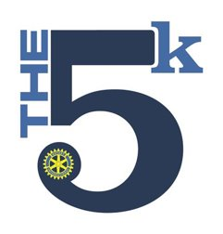
4.
Retire the previous version of the Rotary logo and all uniquely made club logos.
Notes:
And finally, rule #4: Replace your heritage logos with our new refreshed logos. We must tell a consistent story of who we are as members of Rotary, and what we do. That’s our brand. Using the updated brand standards ensure we do that.

Slide 10
INCORRECT USAGE
Notes:
The use of various colors, fonts, and sizes, along with the alteration of the Mark of Excellence is a problem. There is no cohesion or unity. Perhaps all of these programs are part of a larger network, but it’s really hard to tell. And that can cause a potential member, donor or partner to doubt if we are an organization they can trust –- to join, to donate money to, or partner with.
We need our rules when it comes to our logos so we can share a consistent story and message.

Slide 11
CORRECT USAGE

Slide 12
CORRECT USAGE (lockups)

Slide 13
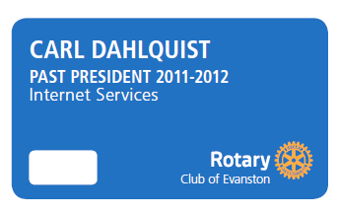
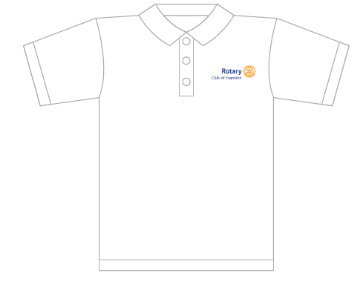
Licensing the logo
-How to do it
-Why its important
Notes:
To ensure that we are protecting our brand, any items produced with our Rotary logo on them must be obtained through an officially licensed vendor. We understand that it’s not always possible to use a licensed vendor. You are unable to use a licensed vendor, your vendor must seek approval from our licensing department. This is a free and easy option for your vendor, and ensures that the logos are being produced correctly. We often see our members wearing apparel that unfortunately does not follow our brand guidelines. The temptation to just google the Rotary logo and choose to produce something you might attractive seems logical. But unfortunately, there are many iterations of the Rotary logo out there, and choosing one that is not official only works to weaken our brand.

Slide 14
RESOURCES
Brand Center - brandcenter.rotary.org​
Your Logos at a Glance
Rotary’s Code of Policies​
Learning Center courses
RPICs
Email brand@rotary.org for questions
Notes:
Rotary has a lot of resources to help you understand and use our Marks correctly.
If you have a question, send it to brand@rotary.org.

